Slide 1




A Year in review
AATD 2024
A. Rembert Koczulla
Marburg/Schönau a.K./Salzburg

Slide 2










Conflicts of interest
A Year in review

Slide 3
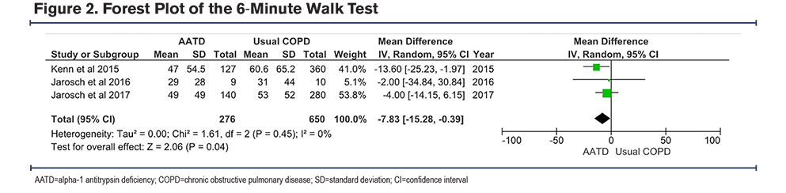
Differences in PR results in a meta-analysis?
PR, pulmonary rehabilitation.
Alwadani FA, et al., Chronic Obstr Pulm Dis. 2024;11(1):121–132.
A Year in review
Notes:
In 3 individual studies,19,23,24 both the AATD and the usual COPD groups showed significant improvement in the 6MWT following PR. However, the usual COPD patients demonstrated slightly better mean improvement compared to the AATD group, and these differences were not significant in any of the studies (see Table 1). Interestingly, the quantitative meta-analysis revealed a significant difference in the 6MWT distance gain between the AATD and usual COPD groups. AATD patients exhibited a lower gain with a Z-score of 2.06, p-value of 0.04, and I2 of 0, with a CI of -7.83m to -0.39m (see Figure 2). It is worth noting that while the numerical difference is lower, it falls within a range that is less than the minimal clinically important difference (MCID) for the 6MWT, making its clinical significance debatable.21 Quality Appraisals of the Included Studies In the assessment using the ROBINS-I tool, Jarosch et al (2017 and2016)19,23 demonstrated serious risk of bias, with areas of missing information further complicating their evaluation. Kenn et al23 and Olfert et al26 both exhibited a moderate risk, though the latter had fewer areas of missing data. The study by Choate et al,25 assessed using the RoB tool for randomized trials, showed a predominantly low risk across categories, but there were some concerns regarding the selection of reported results. Overall, while some studies presented robust methodologies, several had gaps that introduced uncertainty and potential biases. Further details are available in the supplementary materials (see Table 2 and Table 3 in the online supplement, respectively)

Slide 4
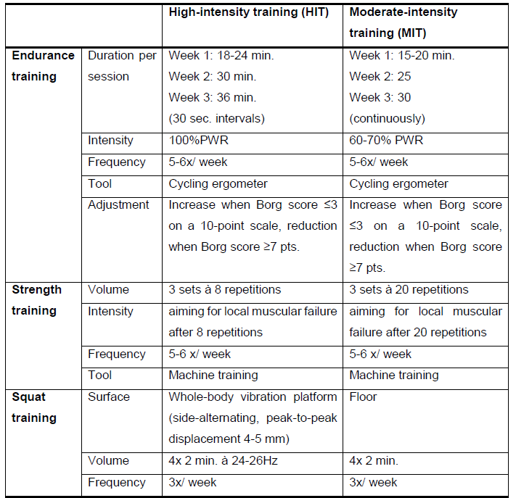
Rehab high-intensity training
PWR, peak work rate.
Jarosch I, et al., Respiration. 2014; In press.
A Year in review

Slide 5
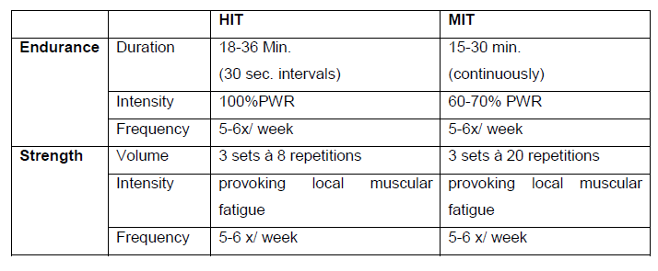
High-intensity vs. moderate-intensity
HIT, high-intensity training; MIT, moderate-intensity training; PWR, peak work rate.
Jarosch I, et al., Respiration. 2014; In press.
A Year in review

Slide 6
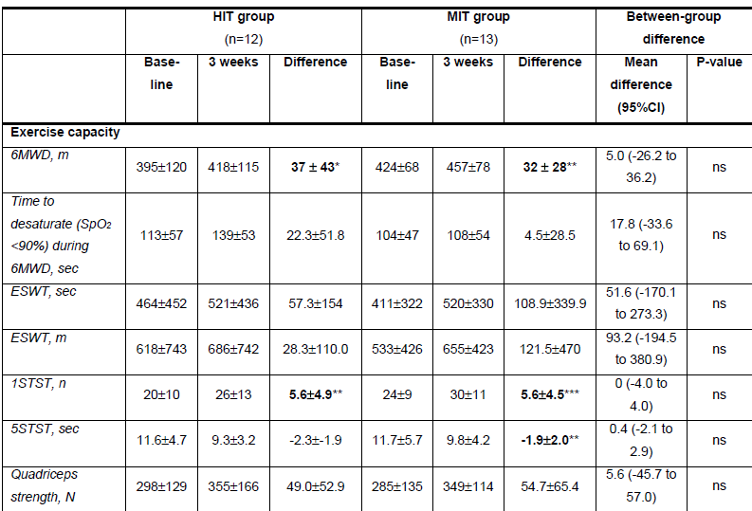
No between-group differences in exercise capacity
No between- group differences!
6MWD, 6-minute walking distance; ESWT, endurance shuttle walk test; HIT, high-intensity training; MIT, moderate-intensity training; ns, non-significant; STST, sit-to-stand test.
Jarosch I, et al., Respiration. 2014; In press.
A Year in review

Slide 7
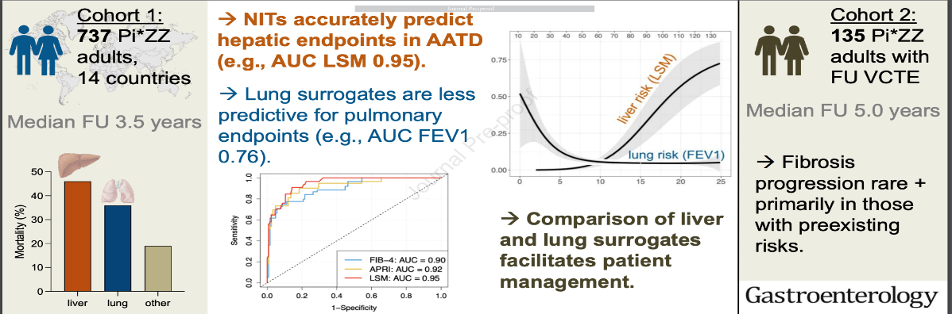
Liver / Longitudinal evaluation of individuals with severe alpha-1 antitrypsin deficiency (Pi*ZZ genotype).
Fromme et al Gastroenterology 2024
A Year in review

Slide 8
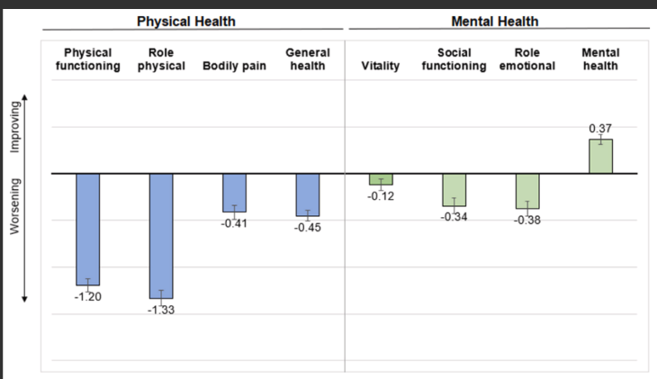
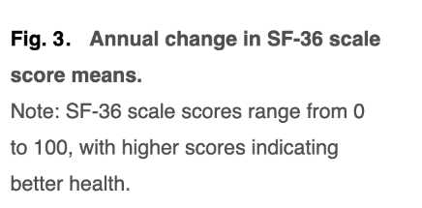
Physical and mental health trajectories: A longitudinal SF-36 analysis in Alpha-1 antitrypsin deficiency-associated COPD
Chioate et al Respir Med
. 2024 Oct 14:234:107838.
A Year in review
Notes:
Background: The Short Form 36-Item Health Survey (SF-36) is a health-related quality of life (HRQoL) measure validated in people with chronic obstructive pulmonary disease (COPD). While physical health is often more impaired than mental health in people with COPD, research on alpha-1 antitrypsin deficiency (AATD)-associated COPD is limited. This longitudinal study examines changes in physical and mental health in individuals with AATD and associated factors.
Methods: Analyses included participants of AlphaNet, a disease management program for individuals with AATD-associated lung disease who are prescribed augmentation therapy. Norm-based SF-36 scores for mental and physical component summaries (MCS and PCS) and 8 scales were analyzed. Linear mixed models evaluated mean changes in SF-36 scores over time.
Results: The study included 2165 participants (mean age 56.9 ± 10.0 years, 47.0 % female). At enrollment, mean PCS score was 37.5 ± 9.6, and mean MCS score was 51.9 ± 10.5. Mean mMRC dyspnea score was 2.3 ± 1.3; 54.6 % had ≥2 exacerbations annually, and 46.5 % used oxygen regularly. Average follow-up was 6.6 ± 3.2 years. The HRQoL remained stable; MCS improved by 0.16 points/year (p < 0.0001), while the PCS score declined by 0.49 points/year (p < 0.0001). Subscales followed similar trends.
Conclusions: At baseline, mental HRQoL scores were higher than physical HRQoL scores, indicating better mental health than physical health in this cohort with AATD-associated lung disease. Stable HRQoL with a slight improvement in mental scores over time and a small decrease in physical scores may be a unique feature of this cohort. Further studies are needed to correlate these findings with disease-specific instruments and patient physiology.
Background: The Short Form 36-Item Health Survey (SF-36) is a health-related quality of life (HRQoL) measure validated in people with chronic obstructive pulmonary disease (COPD). While physical health is often more impaired than mental health in people with COPD, research on alpha-1 antitrypsin deficiency (AATD)-associated COPD is limited. This longitudinal study examines changes in physical and mental health in individuals with AATD and associated factors.
Methods: Analyses included participants of AlphaNet, a disease management program for individuals with AATD-associated lung disease who are prescribed augmentation therapy. Norm-based SF-36 scores for mental and physical component summaries (MCS and PCS) and 8 scales were analyzed. Linear mixed models evaluated mean changes in SF-36 scores over time.
Results: The study included 2165 participants (mean age 56.9 ± 10.0 years, 47.0 % female). At enrollment, mean PCS score was 37.5 ± 9.6, and mean MCS score was 51.9 ± 10.5. Mean mMRC dyspnea score was 2.3 ± 1.3; 54.6 % had ≥2 exacerbations annually, and 46.5 % used oxygen regularly. Average follow-up was 6.6 ± 3.2 years. The HRQoL remained stable; MCS improved by 0.16 points/year (p < 0.0001), while the PCS score declined by 0.49 points/year (p < 0.0001). Subscales followed similar trends.
Conclusions: At baseline, mental HRQoL scores were higher than physical HRQoL scores, indicating better mental health than physical health in this cohort with AATD-associated lung disease. Stable HRQoL with a slight improvement in mental scores over time and a small decrease in physical scores may be a unique feature of this cohort. Further studies are needed to correlate these findings with disease-specific instruments and patient physiology.
Background: The Short Form 36-Item Health Survey (SF-36) is a health-related quality of life (HRQoL) measure validated in people with chronic obstructive pulmonary disease (COPD). While physical health is often more impaired than mental health in people with COPD, research on alpha-1 antitrypsin deficiency (AATD)-associated COPD is limited. This longitudinal study examines changes in physical and mental health in individuals with AATD and associated factors.
Methods: Analyses included participants of AlphaNet, a disease management program for individuals with AATD-associated lung disease who are prescribed augmentation therapy. Norm-based SF-36 scores for mental and physical component summaries (MCS and PCS) and 8 scales were analyzed. Linear mixed models evaluated mean changes in SF-36 scores over time.
Results: The study included 2165 participants (mean age 56.9 ± 10.0 years, 47.0 % female). At enrollment, mean PCS score was 37.5 ± 9.6, and mean MCS score was 51.9 ± 10.5. Mean mMRC dyspnea score was 2.3 ± 1.3; 54.6 % had ≥2 exacerbations annually, and 46.5 % used oxygen regularly. Average follow-up was 6.6 ± 3.2 years. The HRQoL remained stable; MCS improved by 0.16 points/year (p < 0.0001), while the PCS score declined by 0.49 points/year (p < 0.0001). Subscales followed similar trends.
Conclusions: At baseline, mental HRQoL scores were higher than physical HRQoL scores, indicating better mental health than physical health in this cohort with AATD-associated lung disease. Stable HRQoL with a slight improvement in mental scores over time and a small decrease in physical scores may be a unique feature of this cohort. Further studies are needed to correlate these findings with disease-specific instruments and patient physiology.
Background: The Short Form 36-Item Health Survey (SF-36) is a health-related quality of life (HRQoL) measure validated in people with chronic obstructive pulmonary disease (COPD). While physical health is often more impaired than mental health in people with COPD, research on alpha-1 antitrypsin deficiency (AATD)-associated COPD is limited. This longitudinal study examines changes in physical and mental health in individuals with AATD and associated factors.
Methods: Analyses included participants of AlphaNet, a disease management program for individuals with AATD-associated lung disease who are prescribed augmentation therapy. Norm-based SF-36 scores for mental and physical component summaries (MCS and PCS) and 8 scales were analyzed. Linear mixed models evaluated mean changes in SF-36 scores over time.
Results: The study included 2165 participants (mean age 56.9 ± 10.0 years, 47.0 % female). At enrollment, mean PCS score was 37.5 ± 9.6, and mean MCS score was 51.9 ± 10.5. Mean mMRC dyspnea score was 2.3 ± 1.3; 54.6 % had ≥2 exacerbations annually, and 46.5 % used oxygen regularly. Average follow-up was 6.6 ± 3.2 years. The HRQoL remained stable; MCS improved by 0.16 points/year (p < 0.0001), while the PCS score declined by 0.49 points/year (p < 0.0001). Subscales followed similar trends.
Conclusions: At baseline, mental HRQoL scores were higher than physical HRQoL scores, indicating better mental health than physical health in this cohort with AATD-associated lung disease. Stable HRQoL with a slight improvement in mental scores over time and a small decrease in physical scores may be a unique feature of this cohort. Further studies are needed to correlate these findings with disease-specific instruments and patient physiology.

Slide 9
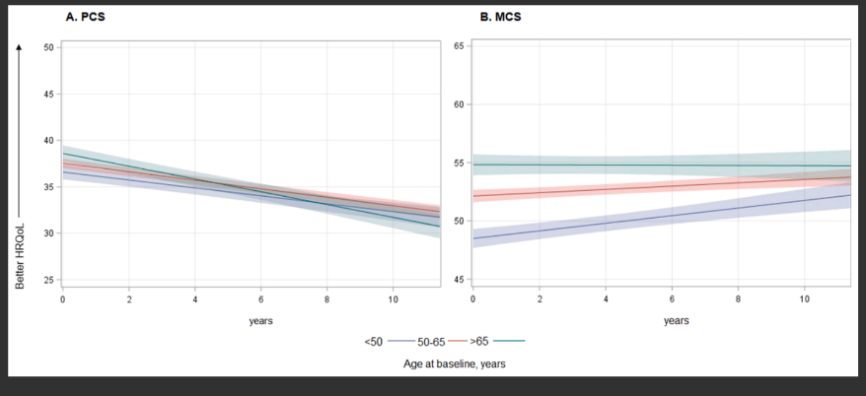
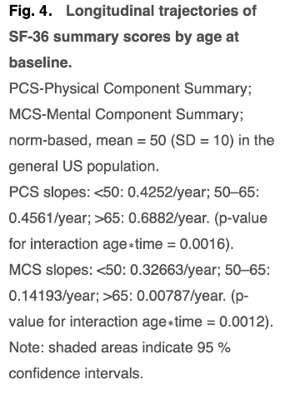
Physical and mental health trajectories: A longitudinal SF-36 analysis in Alpha-1 antitrypsin deficiency-associated COPD
Chioate et al Respir Med
. 2024 Oct 14:234:107838.
A Year in review
Notes:
Background: The Short Form 36-Item Health Survey (SF-36) is a health-related quality of life (HRQoL) measure validated in people with chronic obstructive pulmonary disease (COPD). While physical health is often more impaired than mental health in people with COPD, research on alpha-1 antitrypsin deficiency (AATD)-associated COPD is limited. This longitudinal study examines changes in physical and mental health in individuals with AATD and associated factors.
Methods: Analyses included participants of AlphaNet, a disease management program for individuals with AATD-associated lung disease who are prescribed augmentation therapy. Norm-based SF-36 scores for mental and physical component summaries (MCS and PCS) and 8 scales were analyzed. Linear mixed models evaluated mean changes in SF-36 scores over time.
Results: The study included 2165 participants (mean age 56.9 ± 10.0 years, 47.0 % female). At enrollment, mean PCS score was 37.5 ± 9.6, and mean MCS score was 51.9 ± 10.5. Mean mMRC dyspnea score was 2.3 ± 1.3; 54.6 % had ≥2 exacerbations annually, and 46.5 % used oxygen regularly. Average follow-up was 6.6 ± 3.2 years. The HRQoL remained stable; MCS improved by 0.16 points/year (p < 0.0001), while the PCS score declined by 0.49 points/year (p < 0.0001). Subscales followed similar trends.
Conclusions: At baseline, mental HRQoL scores were higher than physical HRQoL scores, indicating better mental health than physical health in this cohort with AATD-associated lung disease. Stable HRQoL with a slight improvement in mental scores over time and a small decrease in physical scores may be a unique feature of this cohort. Further studies are needed to correlate these findings with disease-specific instruments and patient physiology.
Background: The Short Form 36-Item Health Survey (SF-36) is a health-related quality of life (HRQoL) measure validated in people with chronic obstructive pulmonary disease (COPD). While physical health is often more impaired than mental health in people with COPD, research on alpha-1 antitrypsin deficiency (AATD)-associated COPD is limited. This longitudinal study examines changes in physical and mental health in individuals with AATD and associated factors.
Methods: Analyses included participants of AlphaNet, a disease management program for individuals with AATD-associated lung disease who are prescribed augmentation therapy. Norm-based SF-36 scores for mental and physical component summaries (MCS and PCS) and 8 scales were analyzed. Linear mixed models evaluated mean changes in SF-36 scores over time.
Results: The study included 2165 participants (mean age 56.9 ± 10.0 years, 47.0 % female). At enrollment, mean PCS score was 37.5 ± 9.6, and mean MCS score was 51.9 ± 10.5. Mean mMRC dyspnea score was 2.3 ± 1.3; 54.6 % had ≥2 exacerbations annually, and 46.5 % used oxygen regularly. Average follow-up was 6.6 ± 3.2 years. The HRQoL remained stable; MCS improved by 0.16 points/year (p < 0.0001), while the PCS score declined by 0.49 points/year (p < 0.0001). Subscales followed similar trends.
Conclusions: At baseline, mental HRQoL scores were higher than physical HRQoL scores, indicating better mental health than physical health in this cohort with AATD-associated lung disease. Stable HRQoL with a slight improvement in mental scores over time and a small decrease in physical scores may be a unique feature of this cohort. Further studies are needed to correlate these findings with disease-specific instruments and patient physiology.
Background: The Short Form 36-Item Health Survey (SF-36) is a health-related quality of life (HRQoL) measure validated in people with chronic obstructive pulmonary disease (COPD). While physical health is often more impaired than mental health in people with COPD, research on alpha-1 antitrypsin deficiency (AATD)-associated COPD is limited. This longitudinal study examines changes in physical and mental health in individuals with AATD and associated factors.
Methods: Analyses included participants of AlphaNet, a disease management program for individuals with AATD-associated lung disease who are prescribed augmentation therapy. Norm-based SF-36 scores for mental and physical component summaries (MCS and PCS) and 8 scales were analyzed. Linear mixed models evaluated mean changes in SF-36 scores over time.
Results: The study included 2165 participants (mean age 56.9 ± 10.0 years, 47.0 % female). At enrollment, mean PCS score was 37.5 ± 9.6, and mean MCS score was 51.9 ± 10.5. Mean mMRC dyspnea score was 2.3 ± 1.3; 54.6 % had ≥2 exacerbations annually, and 46.5 % used oxygen regularly. Average follow-up was 6.6 ± 3.2 years. The HRQoL remained stable; MCS improved by 0.16 points/year (p < 0.0001), while the PCS score declined by 0.49 points/year (p < 0.0001). Subscales followed similar trends.
Conclusions: At baseline, mental HRQoL scores were higher than physical HRQoL scores, indicating better mental health than physical health in this cohort with AATD-associated lung disease. Stable HRQoL with a slight improvement in mental scores over time and a small decrease in physical scores may be a unique feature of this cohort. Further studies are needed to correlate these findings with disease-specific instruments and patient physiology.
Background: The Short Form 36-Item Health Survey (SF-36) is a health-related quality of life (HRQoL) measure validated in people with chronic obstructive pulmonary disease (COPD). While physical health is often more impaired than mental health in people with COPD, research on alpha-1 antitrypsin deficiency (AATD)-associated COPD is limited. This longitudinal study examines changes in physical and mental health in individuals with AATD and associated factors.
Methods: Analyses included participants of AlphaNet, a disease management program for individuals with AATD-associated lung disease who are prescribed augmentation therapy. Norm-based SF-36 scores for mental and physical component summaries (MCS and PCS) and 8 scales were analyzed. Linear mixed models evaluated mean changes in SF-36 scores over time.
Results: The study included 2165 participants (mean age 56.9 ± 10.0 years, 47.0 % female). At enrollment, mean PCS score was 37.5 ± 9.6, and mean MCS score was 51.9 ± 10.5. Mean mMRC dyspnea score was 2.3 ± 1.3; 54.6 % had ≥2 exacerbations annually, and 46.5 % used oxygen regularly. Average follow-up was 6.6 ± 3.2 years. The HRQoL remained stable; MCS improved by 0.16 points/year (p < 0.0001), while the PCS score declined by 0.49 points/year (p < 0.0001). Subscales followed similar trends.
Conclusions: At baseline, mental HRQoL scores were higher than physical HRQoL scores, indicating better mental health than physical health in this cohort with AATD-associated lung disease. Stable HRQoL with a slight improvement in mental scores over time and a small decrease in physical scores may be a unique feature of this cohort. Further studies are needed to correlate these findings with disease-specific instruments and patient physiology.

Slide 10
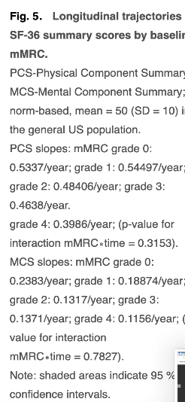
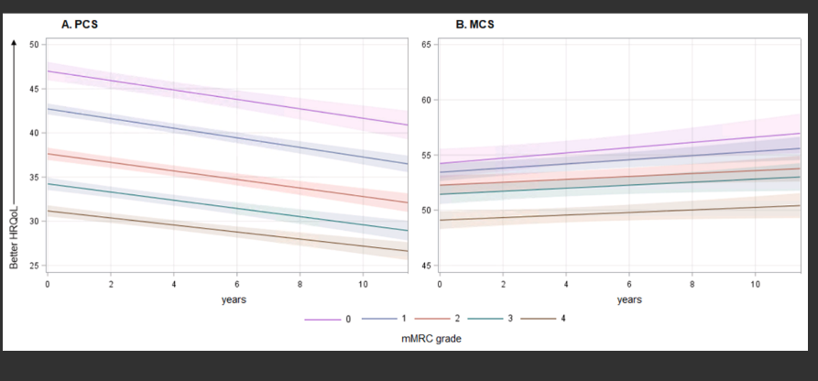
Physical and mental health trajectories: A longitudinal SF-36 analysis in Alpha-1 antitrypsin deficiency-associated COPD
Chioate et al Respir Med
. 2024 Oct 14:234:107838.
A Year in review
Notes:
Background: The Short Form 36-Item Health Survey (SF-36) is a health-related quality of life (HRQoL) measure validated in people with chronic obstructive pulmonary disease (COPD). While physical health is often more impaired than mental health in people with COPD, research on alpha-1 antitrypsin deficiency (AATD)-associated COPD is limited. This longitudinal study examines changes in physical and mental health in individuals with AATD and associated factors.
Methods: Analyses included participants of AlphaNet, a disease management program for individuals with AATD-associated lung disease who are prescribed augmentation therapy. Norm-based SF-36 scores for mental and physical component summaries (MCS and PCS) and 8 scales were analyzed. Linear mixed models evaluated mean changes in SF-36 scores over time.
Results: The study included 2165 participants (mean age 56.9 ± 10.0 years, 47.0 % female). At enrollment, mean PCS score was 37.5 ± 9.6, and mean MCS score was 51.9 ± 10.5. Mean mMRC dyspnea score was 2.3 ± 1.3; 54.6 % had ≥2 exacerbations annually, and 46.5 % used oxygen regularly. Average follow-up was 6.6 ± 3.2 years. The HRQoL remained stable; MCS improved by 0.16 points/year (p < 0.0001), while the PCS score declined by 0.49 points/year (p < 0.0001). Subscales followed similar trends.
Conclusions: At baseline, mental HRQoL scores were higher than physical HRQoL scores, indicating better mental health than physical health in this cohort with AATD-associated lung disease. Stable HRQoL with a slight improvement in mental scores over time and a small decrease in physical scores may be a unique feature of this cohort. Further studies are needed to correlate these findings with disease-specific instruments and patient physiology.
Background: The Short Form 36-Item Health Survey (SF-36) is a health-related quality of life (HRQoL) measure validated in people with chronic obstructive pulmonary disease (COPD). While physical health is often more impaired than mental health in people with COPD, research on alpha-1 antitrypsin deficiency (AATD)-associated COPD is limited. This longitudinal study examines changes in physical and mental health in individuals with AATD and associated factors.
Methods: Analyses included participants of AlphaNet, a disease management program for individuals with AATD-associated lung disease who are prescribed augmentation therapy. Norm-based SF-36 scores for mental and physical component summaries (MCS and PCS) and 8 scales were analyzed. Linear mixed models evaluated mean changes in SF-36 scores over time.
Results: The study included 2165 participants (mean age 56.9 ± 10.0 years, 47.0 % female). At enrollment, mean PCS score was 37.5 ± 9.6, and mean MCS score was 51.9 ± 10.5. Mean mMRC dyspnea score was 2.3 ± 1.3; 54.6 % had ≥2 exacerbations annually, and 46.5 % used oxygen regularly. Average follow-up was 6.6 ± 3.2 years. The HRQoL remained stable; MCS improved by 0.16 points/year (p < 0.0001), while the PCS score declined by 0.49 points/year (p < 0.0001). Subscales followed similar trends.
Conclusions: At baseline, mental HRQoL scores were higher than physical HRQoL scores, indicating better mental health than physical health in this cohort with AATD-associated lung disease. Stable HRQoL with a slight improvement in mental scores over time and a small decrease in physical scores may be a unique feature of this cohort. Further studies are needed to correlate these findings with disease-specific instruments and patient physiology.
Background: The Short Form 36-Item Health Survey (SF-36) is a health-related quality of life (HRQoL) measure validated in people with chronic obstructive pulmonary disease (COPD). While physical health is often more impaired than mental health in people with COPD, research on alpha-1 antitrypsin deficiency (AATD)-associated COPD is limited. This longitudinal study examines changes in physical and mental health in individuals with AATD and associated factors.
Methods: Analyses included participants of AlphaNet, a disease management program for individuals with AATD-associated lung disease who are prescribed augmentation therapy. Norm-based SF-36 scores for mental and physical component summaries (MCS and PCS) and 8 scales were analyzed. Linear mixed models evaluated mean changes in SF-36 scores over time.
Results: The study included 2165 participants (mean age 56.9 ± 10.0 years, 47.0 % female). At enrollment, mean PCS score was 37.5 ± 9.6, and mean MCS score was 51.9 ± 10.5. Mean mMRC dyspnea score was 2.3 ± 1.3; 54.6 % had ≥2 exacerbations annually, and 46.5 % used oxygen regularly. Average follow-up was 6.6 ± 3.2 years. The HRQoL remained stable; MCS improved by 0.16 points/year (p < 0.0001), while the PCS score declined by 0.49 points/year (p < 0.0001). Subscales followed similar trends.
Conclusions: At baseline, mental HRQoL scores were higher than physical HRQoL scores, indicating better mental health than physical health in this cohort with AATD-associated lung disease. Stable HRQoL with a slight improvement in mental scores over time and a small decrease in physical scores may be a unique feature of this cohort. Further studies are needed to correlate these findings with disease-specific instruments and patient physiology.
Background: The Short Form 36-Item Health Survey (SF-36) is a health-related quality of life (HRQoL) measure validated in people with chronic obstructive pulmonary disease (COPD). While physical health is often more impaired than mental health in people with COPD, research on alpha-1 antitrypsin deficiency (AATD)-associated COPD is limited. This longitudinal study examines changes in physical and mental health in individuals with AATD and associated factors.
Methods: Analyses included participants of AlphaNet, a disease management program for individuals with AATD-associated lung disease who are prescribed augmentation therapy. Norm-based SF-36 scores for mental and physical component summaries (MCS and PCS) and 8 scales were analyzed. Linear mixed models evaluated mean changes in SF-36 scores over time.
Results: The study included 2165 participants (mean age 56.9 ± 10.0 years, 47.0 % female). At enrollment, mean PCS score was 37.5 ± 9.6, and mean MCS score was 51.9 ± 10.5. Mean mMRC dyspnea score was 2.3 ± 1.3; 54.6 % had ≥2 exacerbations annually, and 46.5 % used oxygen regularly. Average follow-up was 6.6 ± 3.2 years. The HRQoL remained stable; MCS improved by 0.16 points/year (p < 0.0001), while the PCS score declined by 0.49 points/year (p < 0.0001). Subscales followed similar trends.
Conclusions: At baseline, mental HRQoL scores were higher than physical HRQoL scores, indicating better mental health than physical health in this cohort with AATD-associated lung disease. Stable HRQoL with a slight improvement in mental scores over time and a small decrease in physical scores may be a unique feature of this cohort. Further studies are needed to correlate these findings with disease-specific instruments and patient physiology.

Slide 11
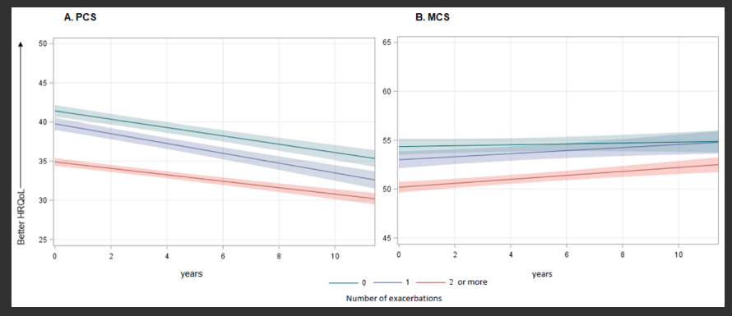
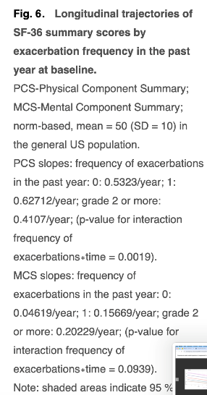
Physical and mental health trajectories: A longitudinal SF-36 analysis in Alpha-1 antitrypsin deficiency-associated COPD
Chioate et al Respir Med
. 2024 Oct 14:234:107838.
A Year in review
Notes:
Background: The Short Form 36-Item Health Survey (SF-36) is a health-related quality of life (HRQoL) measure validated in people with chronic obstructive pulmonary disease (COPD). While physical health is often more impaired than mental health in people with COPD, research on alpha-1 antitrypsin deficiency (AATD)-associated COPD is limited. This longitudinal study examines changes in physical and mental health in individuals with AATD and associated factors.
Methods: Analyses included participants of AlphaNet, a disease management program for individuals with AATD-associated lung disease who are prescribed augmentation therapy. Norm-based SF-36 scores for mental and physical component summaries (MCS and PCS) and 8 scales were analyzed. Linear mixed models evaluated mean changes in SF-36 scores over time.
Results: The study included 2165 participants (mean age 56.9 ± 10.0 years, 47.0 % female). At enrollment, mean PCS score was 37.5 ± 9.6, and mean MCS score was 51.9 ± 10.5. Mean mMRC dyspnea score was 2.3 ± 1.3; 54.6 % had ≥2 exacerbations annually, and 46.5 % used oxygen regularly. Average follow-up was 6.6 ± 3.2 years. The HRQoL remained stable; MCS improved by 0.16 points/year (p < 0.0001), while the PCS score declined by 0.49 points/year (p < 0.0001). Subscales followed similar trends.
Conclusions: At baseline, mental HRQoL scores were higher than physical HRQoL scores, indicating better mental health than physical health in this cohort with AATD-associated lung disease. Stable HRQoL with a slight improvement in mental scores over time and a small decrease in physical scores may be a unique feature of this cohort. Further studies are needed to correlate these findings with disease-specific instruments and patient physiology.
Background: The Short Form 36-Item Health Survey (SF-36) is a health-related quality of life (HRQoL) measure validated in people with chronic obstructive pulmonary disease (COPD). While physical health is often more impaired than mental health in people with COPD, research on alpha-1 antitrypsin deficiency (AATD)-associated COPD is limited. This longitudinal study examines changes in physical and mental health in individuals with AATD and associated factors.
Methods: Analyses included participants of AlphaNet, a disease management program for individuals with AATD-associated lung disease who are prescribed augmentation therapy. Norm-based SF-36 scores for mental and physical component summaries (MCS and PCS) and 8 scales were analyzed. Linear mixed models evaluated mean changes in SF-36 scores over time.
Results: The study included 2165 participants (mean age 56.9 ± 10.0 years, 47.0 % female). At enrollment, mean PCS score was 37.5 ± 9.6, and mean MCS score was 51.9 ± 10.5. Mean mMRC dyspnea score was 2.3 ± 1.3; 54.6 % had ≥2 exacerbations annually, and 46.5 % used oxygen regularly. Average follow-up was 6.6 ± 3.2 years. The HRQoL remained stable; MCS improved by 0.16 points/year (p < 0.0001), while the PCS score declined by 0.49 points/year (p < 0.0001). Subscales followed similar trends.
Conclusions: At baseline, mental HRQoL scores were higher than physical HRQoL scores, indicating better mental health than physical health in this cohort with AATD-associated lung disease. Stable HRQoL with a slight improvement in mental scores over time and a small decrease in physical scores may be a unique feature of this cohort. Further studies are needed to correlate these findings with disease-specific instruments and patient physiology.
Background: The Short Form 36-Item Health Survey (SF-36) is a health-related quality of life (HRQoL) measure validated in people with chronic obstructive pulmonary disease (COPD). While physical health is often more impaired than mental health in people with COPD, research on alpha-1 antitrypsin deficiency (AATD)-associated COPD is limited. This longitudinal study examines changes in physical and mental health in individuals with AATD and associated factors.
Methods: Analyses included participants of AlphaNet, a disease management program for individuals with AATD-associated lung disease who are prescribed augmentation therapy. Norm-based SF-36 scores for mental and physical component summaries (MCS and PCS) and 8 scales were analyzed. Linear mixed models evaluated mean changes in SF-36 scores over time.
Results: The study included 2165 participants (mean age 56.9 ± 10.0 years, 47.0 % female). At enrollment, mean PCS score was 37.5 ± 9.6, and mean MCS score was 51.9 ± 10.5. Mean mMRC dyspnea score was 2.3 ± 1.3; 54.6 % had ≥2 exacerbations annually, and 46.5 % used oxygen regularly. Average follow-up was 6.6 ± 3.2 years. The HRQoL remained stable; MCS improved by 0.16 points/year (p < 0.0001), while the PCS score declined by 0.49 points/year (p < 0.0001). Subscales followed similar trends.
Conclusions: At baseline, mental HRQoL scores were higher than physical HRQoL scores, indicating better mental health than physical health in this cohort with AATD-associated lung disease. Stable HRQoL with a slight improvement in mental scores over time and a small decrease in physical scores may be a unique feature of this cohort. Further studies are needed to correlate these findings with disease-specific instruments and patient physiology.
Background: The Short Form 36-Item Health Survey (SF-36) is a health-related quality of life (HRQoL) measure validated in people with chronic obstructive pulmonary disease (COPD). While physical health is often more impaired than mental health in people with COPD, research on alpha-1 antitrypsin deficiency (AATD)-associated COPD is limited. This longitudinal study examines changes in physical and mental health in individuals with AATD and associated factors.
Methods: Analyses included participants of AlphaNet, a disease management program for individuals with AATD-associated lung disease who are prescribed augmentation therapy. Norm-based SF-36 scores for mental and physical component summaries (MCS and PCS) and 8 scales were analyzed. Linear mixed models evaluated mean changes in SF-36 scores over time.
Results: The study included 2165 participants (mean age 56.9 ± 10.0 years, 47.0 % female). At enrollment, mean PCS score was 37.5 ± 9.6, and mean MCS score was 51.9 ± 10.5. Mean mMRC dyspnea score was 2.3 ± 1.3; 54.6 % had ≥2 exacerbations annually, and 46.5 % used oxygen regularly. Average follow-up was 6.6 ± 3.2 years. The HRQoL remained stable; MCS improved by 0.16 points/year (p < 0.0001), while the PCS score declined by 0.49 points/year (p < 0.0001). Subscales followed similar trends.
Conclusions: At baseline, mental HRQoL scores were higher than physical HRQoL scores, indicating better mental health than physical health in this cohort with AATD-associated lung disease. Stable HRQoL with a slight improvement in mental scores over time and a small decrease in physical scores may be a unique feature of this cohort. Further studies are needed to correlate these findings with disease-specific instruments and patient physiology.

Slide 12
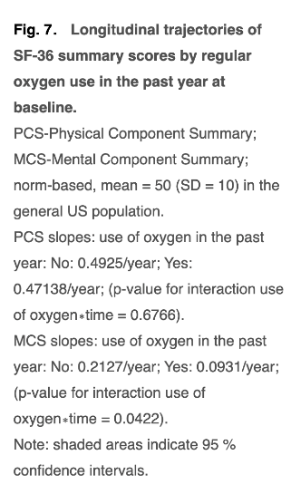
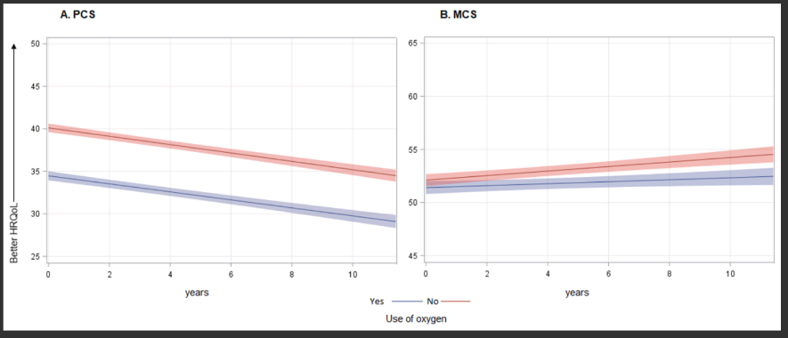
Physical and mental health trajectories: A longitudinal SF-36 analysis in Alpha-1 antitrypsin deficiency-associated COPD
Chioate et al Respir Med
. 2024 Oct 14:234:107838.
A Year in review
Notes:
Background: The Short Form 36-Item Health Survey (SF-36) is a health-related quality of life (HRQoL) measure validated in people with chronic obstructive pulmonary disease (COPD). While physical health is often more impaired than mental health in people with COPD, research on alpha-1 antitrypsin deficiency (AATD)-associated COPD is limited. This longitudinal study examines changes in physical and mental health in individuals with AATD and associated factors.
Methods: Analyses included participants of AlphaNet, a disease management program for individuals with AATD-associated lung disease who are prescribed augmentation therapy. Norm-based SF-36 scores for mental and physical component summaries (MCS and PCS) and 8 scales were analyzed. Linear mixed models evaluated mean changes in SF-36 scores over time.
Results: The study included 2165 participants (mean age 56.9 ± 10.0 years, 47.0 % female). At enrollment, mean PCS score was 37.5 ± 9.6, and mean MCS score was 51.9 ± 10.5. Mean mMRC dyspnea score was 2.3 ± 1.3; 54.6 % had ≥2 exacerbations annually, and 46.5 % used oxygen regularly. Average follow-up was 6.6 ± 3.2 years. The HRQoL remained stable; MCS improved by 0.16 points/year (p < 0.0001), while the PCS score declined by 0.49 points/year (p < 0.0001). Subscales followed similar trends.
Conclusions: At baseline, mental HRQoL scores were higher than physical HRQoL scores, indicating better mental health than physical health in this cohort with AATD-associated lung disease. Stable HRQoL with a slight improvement in mental scores over time and a small decrease in physical scores may be a unique feature of this cohort. Further studies are needed to correlate these findings with disease-specific instruments and patient physiology.
Background: The Short Form 36-Item Health Survey (SF-36) is a health-related quality of life (HRQoL) measure validated in people with chronic obstructive pulmonary disease (COPD). While physical health is often more impaired than mental health in people with COPD, research on alpha-1 antitrypsin deficiency (AATD)-associated COPD is limited. This longitudinal study examines changes in physical and mental health in individuals with AATD and associated factors.
Methods: Analyses included participants of AlphaNet, a disease management program for individuals with AATD-associated lung disease who are prescribed augmentation therapy. Norm-based SF-36 scores for mental and physical component summaries (MCS and PCS) and 8 scales were analyzed. Linear mixed models evaluated mean changes in SF-36 scores over time.
Results: The study included 2165 participants (mean age 56.9 ± 10.0 years, 47.0 % female). At enrollment, mean PCS score was 37.5 ± 9.6, and mean MCS score was 51.9 ± 10.5. Mean mMRC dyspnea score was 2.3 ± 1.3; 54.6 % had ≥2 exacerbations annually, and 46.5 % used oxygen regularly. Average follow-up was 6.6 ± 3.2 years. The HRQoL remained stable; MCS improved by 0.16 points/year (p < 0.0001), while the PCS score declined by 0.49 points/year (p < 0.0001). Subscales followed similar trends.
Conclusions: At baseline, mental HRQoL scores were higher than physical HRQoL scores, indicating better mental health than physical health in this cohort with AATD-associated lung disease. Stable HRQoL with a slight improvement in mental scores over time and a small decrease in physical scores may be a unique feature of this cohort. Further studies are needed to correlate these findings with disease-specific instruments and patient physiology.
Background: The Short Form 36-Item Health Survey (SF-36) is a health-related quality of life (HRQoL) measure validated in people with chronic obstructive pulmonary disease (COPD). While physical health is often more impaired than mental health in people with COPD, research on alpha-1 antitrypsin deficiency (AATD)-associated COPD is limited. This longitudinal study examines changes in physical and mental health in individuals with AATD and associated factors.
Methods: Analyses included participants of AlphaNet, a disease management program for individuals with AATD-associated lung disease who are prescribed augmentation therapy. Norm-based SF-36 scores for mental and physical component summaries (MCS and PCS) and 8 scales were analyzed. Linear mixed models evaluated mean changes in SF-36 scores over time.
Results: The study included 2165 participants (mean age 56.9 ± 10.0 years, 47.0 % female). At enrollment, mean PCS score was 37.5 ± 9.6, and mean MCS score was 51.9 ± 10.5. Mean mMRC dyspnea score was 2.3 ± 1.3; 54.6 % had ≥2 exacerbations annually, and 46.5 % used oxygen regularly. Average follow-up was 6.6 ± 3.2 years. The HRQoL remained stable; MCS improved by 0.16 points/year (p < 0.0001), while the PCS score declined by 0.49 points/year (p < 0.0001). Subscales followed similar trends.
Conclusions: At baseline, mental HRQoL scores were higher than physical HRQoL scores, indicating better mental health than physical health in this cohort with AATD-associated lung disease. Stable HRQoL with a slight improvement in mental scores over time and a small decrease in physical scores may be a unique feature of this cohort. Further studies are needed to correlate these findings with disease-specific instruments and patient physiology.
Background: The Short Form 36-Item Health Survey (SF-36) is a health-related quality of life (HRQoL) measure validated in people with chronic obstructive pulmonary disease (COPD). While physical health is often more impaired than mental health in people with COPD, research on alpha-1 antitrypsin deficiency (AATD)-associated COPD is limited. This longitudinal study examines changes in physical and mental health in individuals with AATD and associated factors.
Methods: Analyses included participants of AlphaNet, a disease management program for individuals with AATD-associated lung disease who are prescribed augmentation therapy. Norm-based SF-36 scores for mental and physical component summaries (MCS and PCS) and 8 scales were analyzed. Linear mixed models evaluated mean changes in SF-36 scores over time.
Results: The study included 2165 participants (mean age 56.9 ± 10.0 years, 47.0 % female). At enrollment, mean PCS score was 37.5 ± 9.6, and mean MCS score was 51.9 ± 10.5. Mean mMRC dyspnea score was 2.3 ± 1.3; 54.6 % had ≥2 exacerbations annually, and 46.5 % used oxygen regularly. Average follow-up was 6.6 ± 3.2 years. The HRQoL remained stable; MCS improved by 0.16 points/year (p < 0.0001), while the PCS score declined by 0.49 points/year (p < 0.0001). Subscales followed similar trends.
Conclusions: At baseline, mental HRQoL scores were higher than physical HRQoL scores, indicating better mental health than physical health in this cohort with AATD-associated lung disease. Stable HRQoL with a slight improvement in mental scores over time and a small decrease in physical scores may be a unique feature of this cohort. Further studies are needed to correlate these findings with disease-specific instruments and patient physiology.

Slide 13
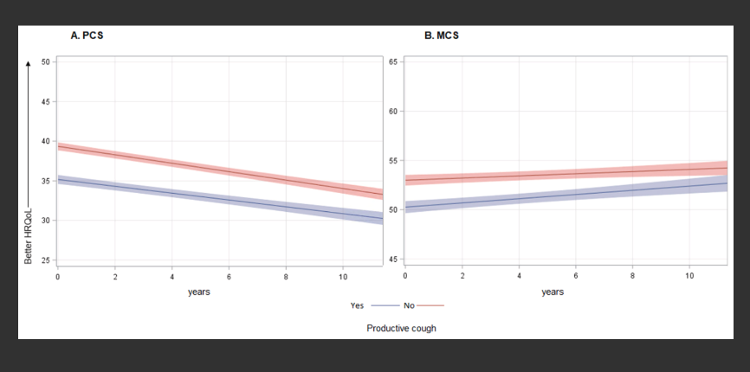
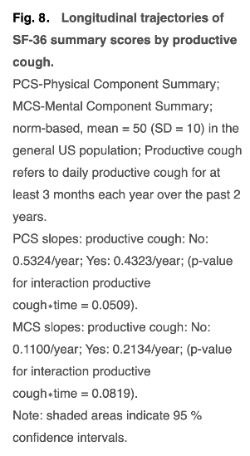
Physical and mental health trajectories: A longitudinal SF-36 analysis in Alpha-1 antitrypsin deficiency-associated COPD
Chioate et al Respir
Med. 2024 Oct 14:234:107838.
A Year in review

Slide 14
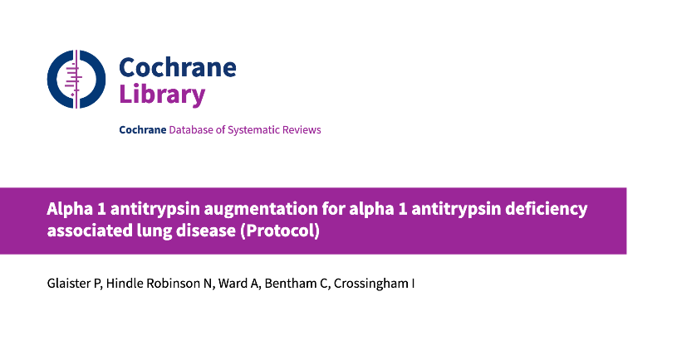
Cochrane
A Year in review

Slide 15

Cochrane
A Year in review

Slide 16
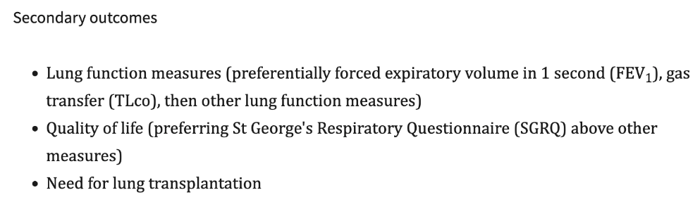
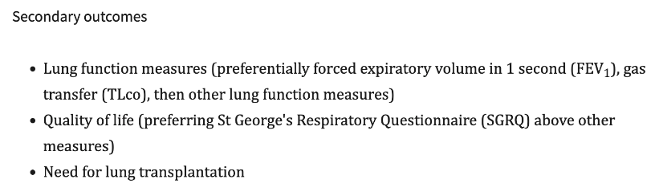
Cochrane
A Year in review

Slide 17
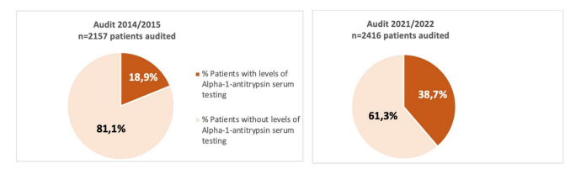
Awarenessprogramme- Beispiel Spanien
Calle-Rubio et al. J. Clin Med 2024
A Year in review
Notes:
Abstract: Background: Alpha-1 antitrypsin deficiency (AATD) is an underdiagnosed condition despite being one of the most common inherited disorders in adults that is associated with an increased risk of developing chronic obstructive pulmonary disease (COPD). The aim was to evaluate the frequency of performing AAT levels and associated factors in COPD patients in an audit conducted in 2021–2022, as well as to compare with a previous audit conducted in 2014–2015. Methods: EPOCONSUL 2021 is a cross-sectional audit that evaluated the outpatient care provided to COPD patients in respiratory clinics in Spain based on available data from medical registries. Results: 4225 patients with a diagnosis of COPD from 45 centers were audited in 2021. A total of 1670 (39.5%) patients underwent AAT determination. Being treated at a specialized COPD outpatient clinic (OR 1.88, p = 0.007), age ≤ 55 years old (OR 1.84, p = 0.007) and a FEV1 < 50% (OR 1.86, p < 0.001) were associated with a higher likelihood of being tested for AAT, while Charlson index ≥ 3 (OR 0.63, p < 0.001) and genotyping of AATD availability (OR 0.42, p < 0.001) showed a statistically significant negative association. The analysis of cases included in respiratory units that participated in both audits showed an increase in the proportion of cases with AAT serum level testing available (adjusted OR 2.81, p < 0.001). The percentage of individuals with serum AAT levels < 60 mg/dL (a severe AATD) was 4%. Conclusions: Our analysis identifies significant improvements in adherence to the recommendation to test AAT levels in COPD patients, performed in 4 out of 10 patients, being more likely at younger ages and with higher COPD severity, and with a detection of severe AATD of 4% among those tested, suggesting that clinicians still perform AAT testing in COPD patients selectively. Therefore, efforts are still needed to optimize AATD screening and establish new early detection strategies to reduce morbidity and mortality in these patients.

Slide 18
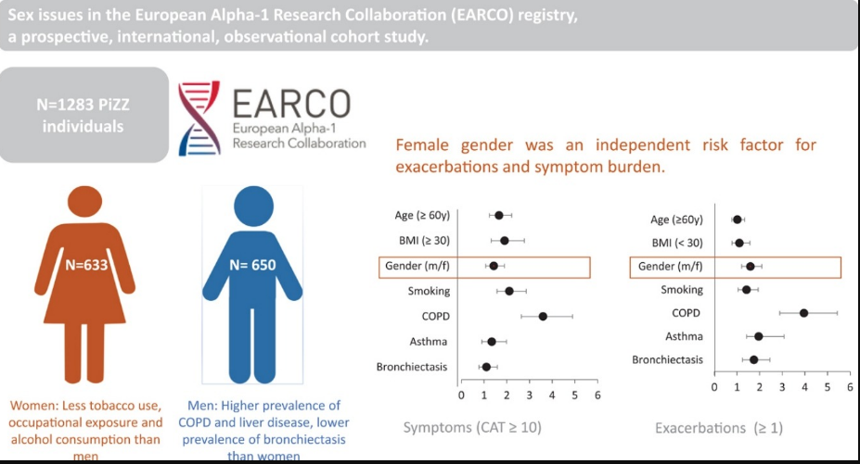
AAT und Geschlecht
A Year in review
Ersöz et al.
Arch Bronconeumol 2024 et al.
Notes:
ex and gender influence many aspects of chronic obstructive pulmonary disease (COPD). Limited data are available on this topic in alpha-1 antitrypsin deficiency (AATD). We therefore aimed to investigate sex issues in the EARCO registry, a prospective, international, observational cohort study.
Methods
Baseline data from PiZZ individuals, enrolled in the registry with complete data on sex and smoking history were analysed by group comparisons and binary logistic regression analyses.
Results
1283 patients with AATD, 49.3% women were analysed. Females reported less tobacco consumption (16.8 ± 12.2 vs. 19.6 ± 14.5 PY, p = 0.006), occupational exposures towards gases, dusts or asbestos (p < 0.005 each) and consumed less alcohol (5.5 ± 7.6 vs. 8.4 ± 10.3 u/week, p < 0.001). Females reported COPD (41% vs. 57%, p < 0.001) and liver disease (11% vs. 20%, p < 0.001) less often. However, they had a higher prevalence of bronchiectasis (24% vs. 13%, p < 0.001). Despite better lung function (FEV₁%pred. 73.6 ± 29.9 vs. 62.7 ± 29.5, p < 0.001) females reported a similar symptom burden (CAT 13.4 ± 9.5 vs. 12.5 ± 8.9, p = ns) and exacerbation frequency (at least one in the previous year 30% vs. 26%, p = ns) compared to males. In multivariate analyses, female sex was an independent risk factor for exacerbations in the previous year OR 1.6 p = 0.001 in addition to smoking history, COPD, asthma and bronchiectasis and was also identified as risk factors for symptom burden (CAT ≥ 10) OR 1.4 p = 0.014 besides age, BMI, COPD and smoking history.
Conclusion
Men had higher rates of COPD and liver disease, women were more likely to have bronchiectasis. Women's higher symptom burden and exacerbation frequency suggest they may need tailored treatment approaches.

Slide 19
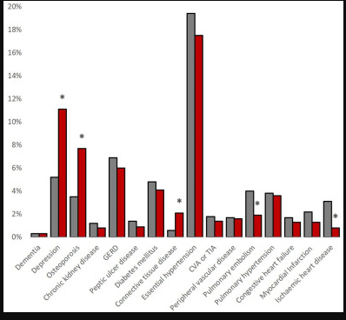
AATD und Geschlecht
Ersöz et al. Arch Bronconeumol 2024 et al.
A Year in review

Slide 20
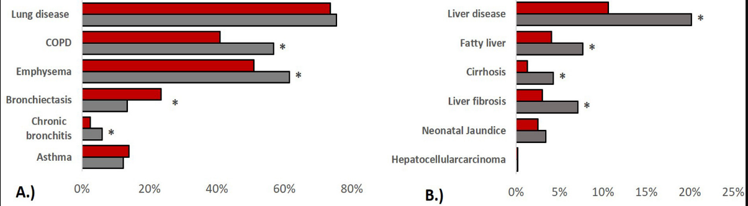
AATD und Geschlecht
Ersöz et al. Arch Bronconeumol 2024 et al.
A Year in review
Notes:
ex and gender influence many aspects of chronic obstructive pulmonary disease (COPD). Limited data are available on this topic in alpha-1 antitrypsin deficiency (AATD). We therefore aimed to investigate sex issues in the EARCO registry, a prospective, international, observational cohort study.
Methods
Baseline data from PiZZ individuals, enrolled in the registry with complete data on sex and smoking history were analysed by group comparisons and binary logistic regression analyses.
Results
1283 patients with AATD, 49.3% women were analysed. Females reported less tobacco consumption (16.8 ± 12.2 vs. 19.6 ± 14.5 PY, p = 0.006), occupational exposures towards gases, dusts or asbestos (p < 0.005 each) and consumed less alcohol (5.5 ± 7.6 vs. 8.4 ± 10.3 u/week, p < 0.001). Females reported COPD (41% vs. 57%, p < 0.001) and liver disease (11% vs. 20%, p < 0.001) less often. However, they had a higher prevalence of bronchiectasis (24% vs. 13%, p < 0.001). Despite better lung function (FEV₁%pred. 73.6 ± 29.9 vs. 62.7 ± 29.5, p < 0.001) females reported a similar symptom burden (CAT 13.4 ± 9.5 vs. 12.5 ± 8.9, p = ns) and exacerbation frequency (at least one in the previous year 30% vs. 26%, p = ns) compared to males. In multivariate analyses, female sex was an independent risk factor for exacerbations in the previous year OR 1.6 p = 0.001 in addition to smoking history, COPD, asthma and bronchiectasis and was also identified as risk factors for symptom burden (CAT ≥ 10) OR 1.4 p = 0.014 besides age, BMI, COPD and smoking history.
Conclusion
Men had higher rates of COPD and liver disease, women were more likely to have bronchiectasis. Women's higher symptom burden and exacerbation frequency suggest they may need tailored treatment approaches.

